Slide 1


Ratchet based ion
movement simulator
Project Number: 22-1-1-2475
Names: Yotam Gur & Dor Ender
Advisor: Dr. Gideon Segev

Slide 2
Project Subject
Implementation of AI algorithms to optimize ion separation in advanced ratchet systems to receive ultimate potential profiles parameters to separate ions

Slide 3
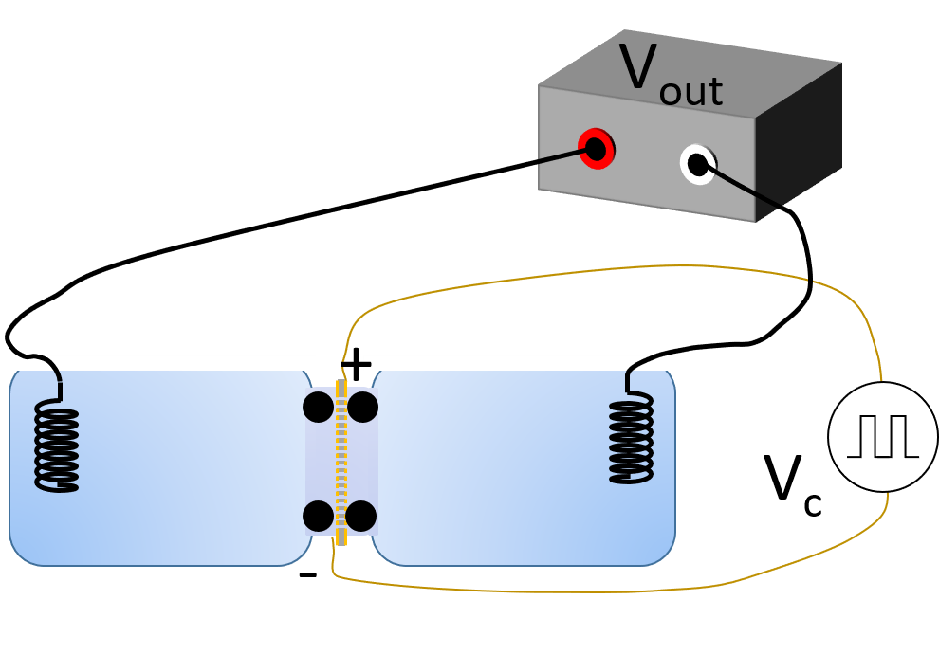
Introduction
Part of ongoing development of selective ion pump.
Monte-Carlo calculations
AI Algorithm- simulation optimization

Slide 4

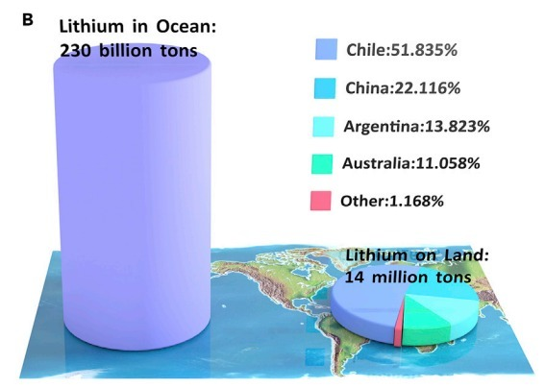
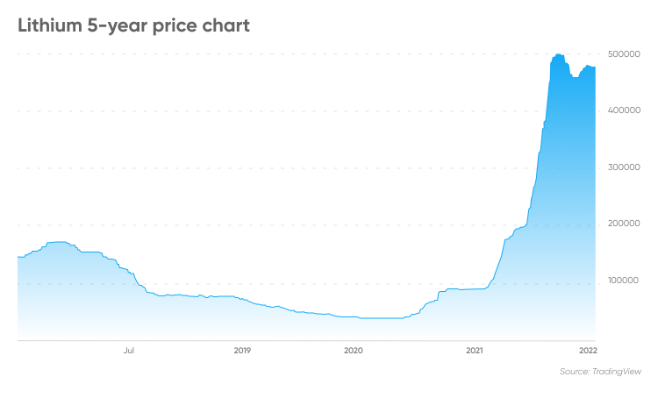
Water desalination systems.
Extraction of metals out of sea water.

Slide 5


Goals
Improve simulation’s running time.
Proof of ability of the system to separate ions.
AI algorithm to find best separation parameters.

Slide 6
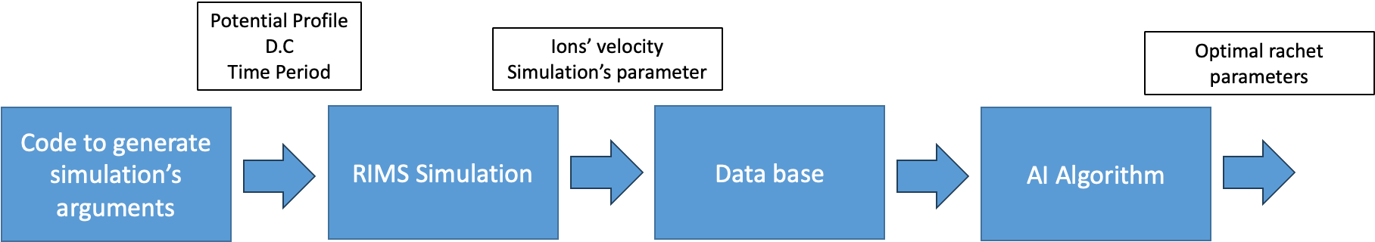
Block Diagram

Slide 7

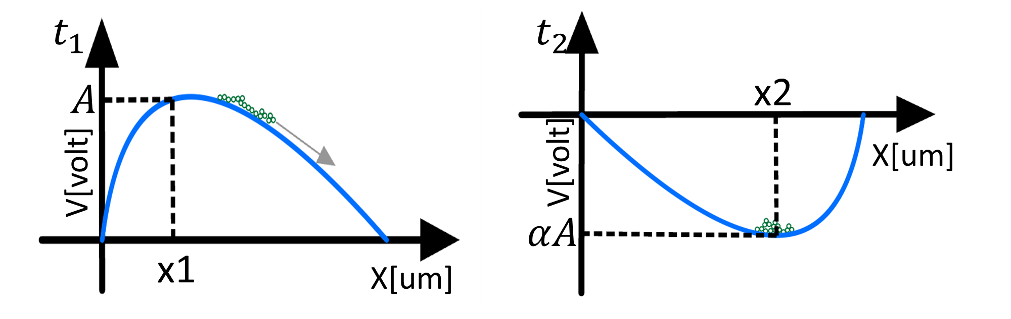

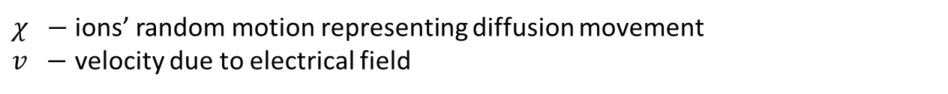
Monte-Carlo calculations
$$x_{t+Δt}=x_{t}+v∙Δt+χ$$
$χ −$ions’ random motion representing diffusion movement
$v −$ velocity due to electrical field
Smooth potential profiles

Slide 8
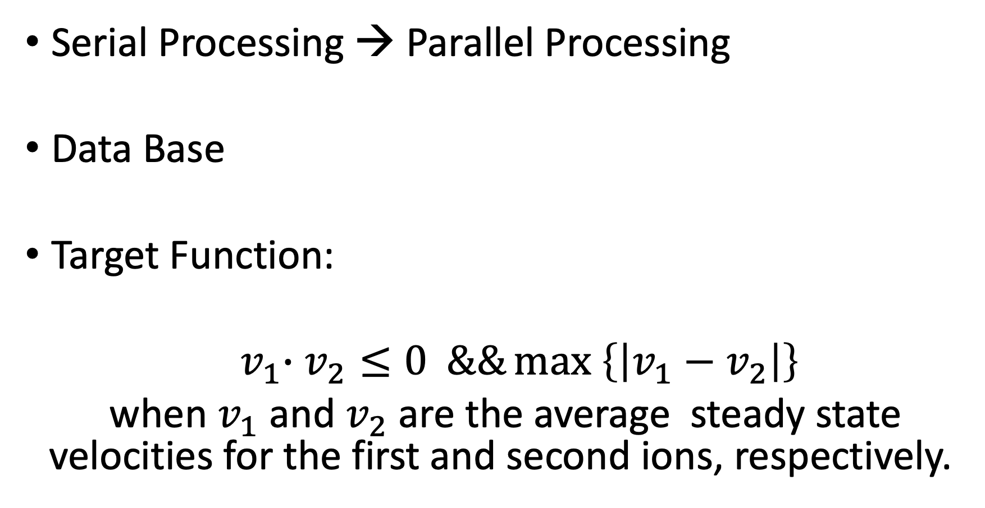
Serial Processing → Parallel Processing
Data Base
Target Function:
${ v}_{1}∙v_{2}≤0 \&\&\max\left\{\left|v_{1}−v_{2}\right|\right\}$
when $v_{1}$ and $v_{2}$ are the average steady state velocities for the first and second ions, respectively.

Slide 9

Database
Manually adjusted the ability to separate Sodium and Potassium ions

Slide 10

Demonstration

Slide 11

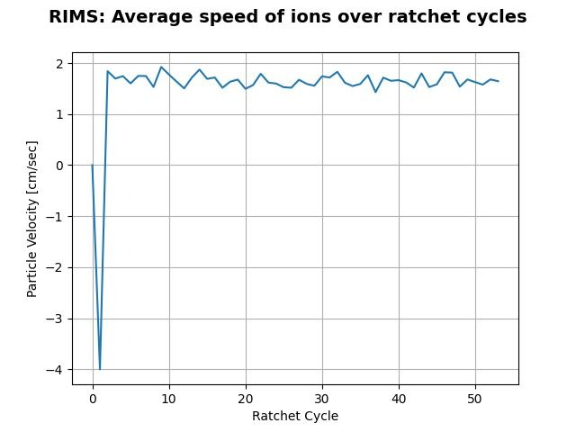
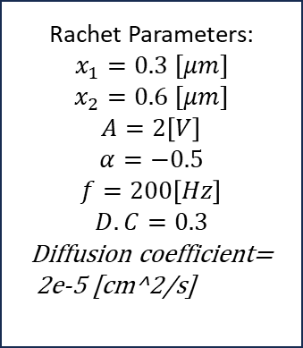
Rachet Parameters:
$$x_{1}=0.3 [μm]$$
$$x_{2}=0.6 [μm]$$
$$A=2\left[V\right]$$
$$α=−0.5$$
$$f=200\left[Hz\right]$$
$$D.C=0.3$$
$$\text{Diffusion} \text{coefficient}\text{= 2}\text{e}\text{−5 [}\text{cm}\text{^2/}\text{s}\text{] }$$

Slide 12
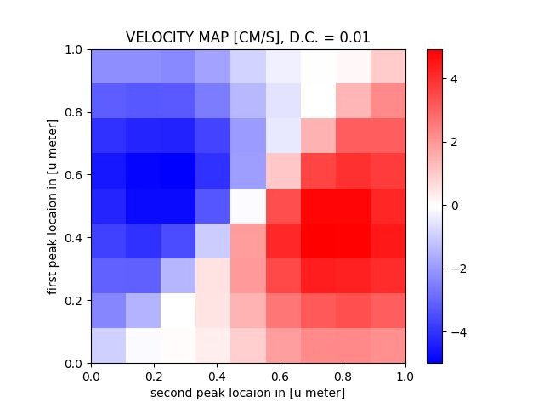
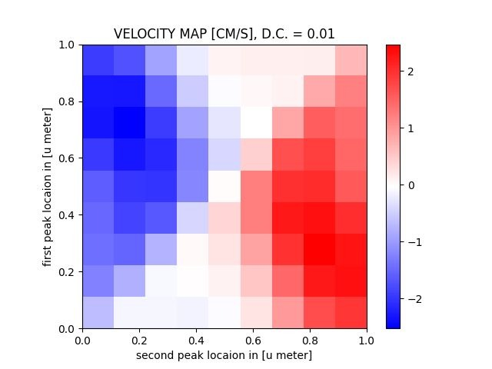
Velocity Map of Potassium ions [cm/s]
Duty Cycle = 30%
Velocity Map of Sodium ions [cm/s]
Duty Cycle = 30%
Simulation’s parameters:
Amplitude=1V
Alpha=-1
Frequency=100 KHz

Slide 13
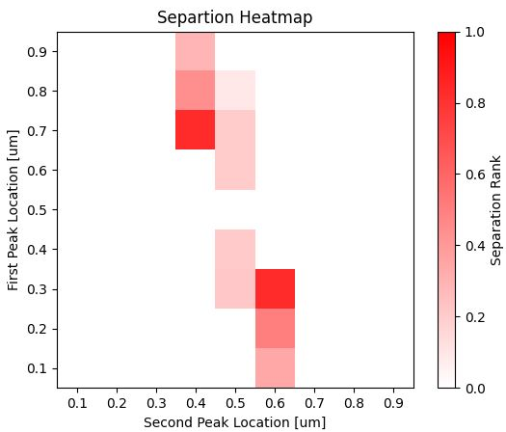
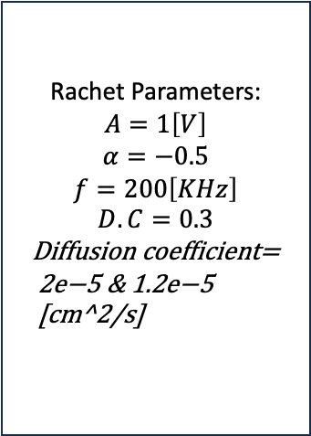
Separation Score
Rachet Parameters:
$$A=1\left[V\right]$$
$$α=−0.5$$
$$f=200\left[KHz\right]$$
$$D.C=0.3$$
$$\text{Diffusion} \text{coefficient}\text{= 2}\text{e}\text{−5 \& 1.2}\text{e}\text{−}\text{5 [}\text{cm}\text{^2/}\text{s}\text{] }$$
Separation Velocity [cm/s]
*Score 0 (white) is nonseparation.

Slide 14
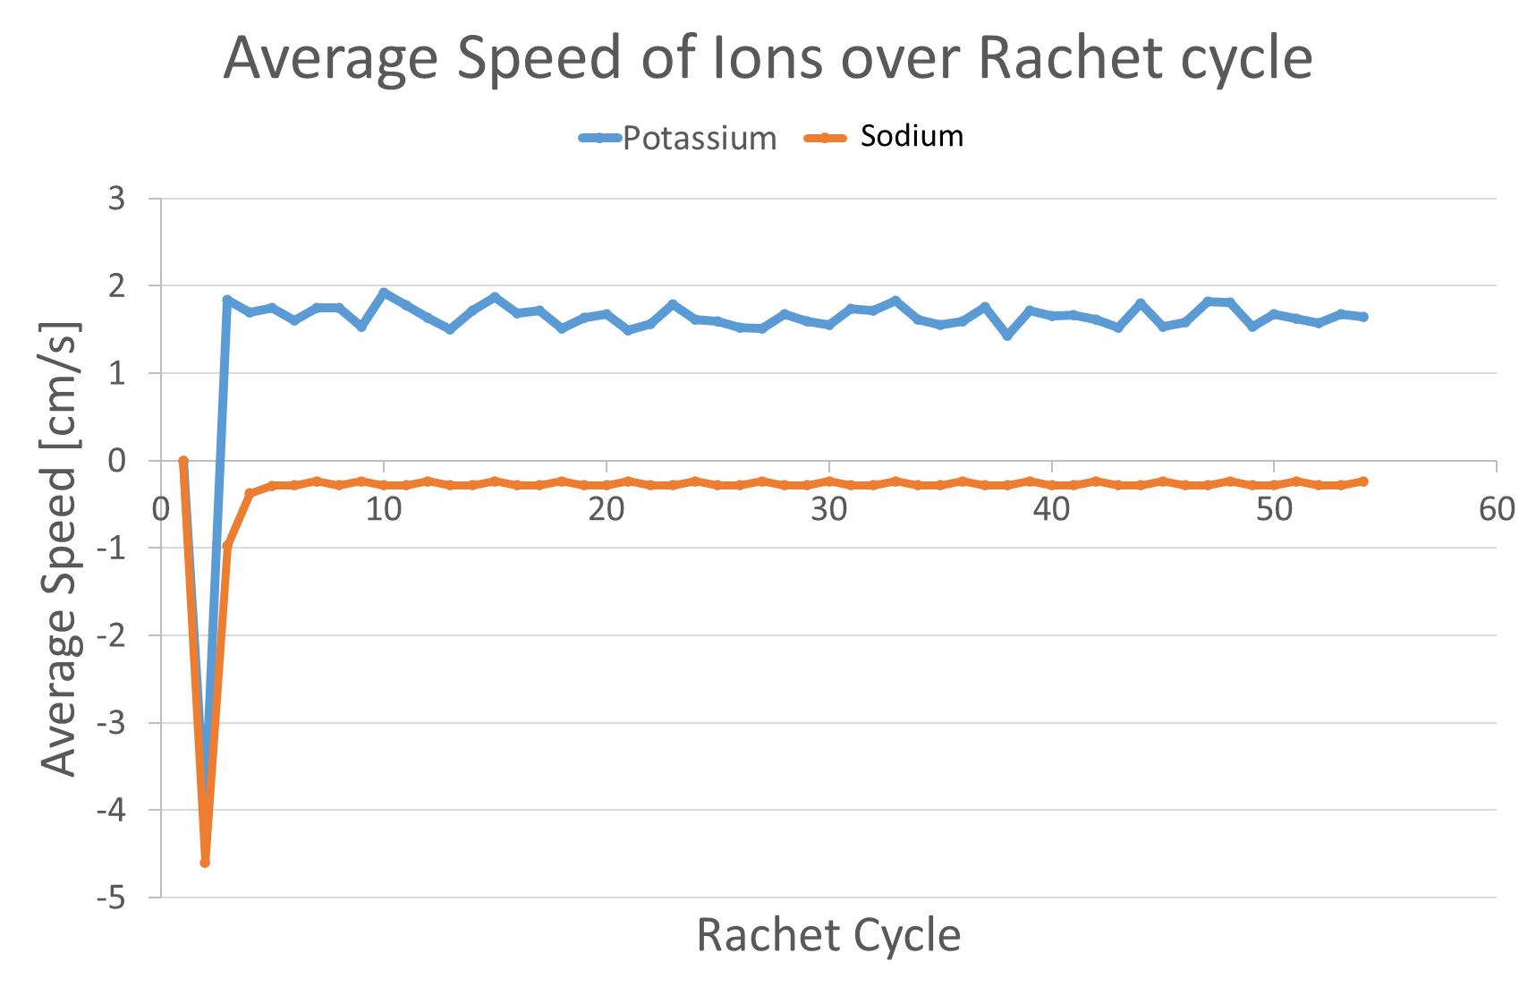
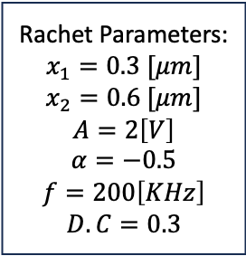
Rachet Parameters:
$$x_{1}=0.3 [μm]$$
$$x_{2}=0.6 [μm]$$
$$A=2\left[V\right]$$
$$α=−0.5$$
$$f=200\left[KHz\right]$$
$$D.C=0.3$$

Slide 15
Conclusions
The rachet can separate Sodium from Potassium.
Best separations were performed under the following parameter:
Amplitude ≈ 2 [V]
Alpha ≈ -0.5
Frequency ≈ 200-300 [KHz]
Duty Cycle ≈ 0.25-0.4

Slide 16
Conclusions
Parameters | Article original simulation (via comsol) | New simulation method
Amplitude [V] | 2.5 | 2
Alpha | -0.5 | -0.5
Frequency [KHz] | 83 | 200
Duty Cycle | 25% | 30%
First Peak Location (x1) [um] | 0.7 | 0.3
Second Peak Location (x2) [um] | 0.7 | 0.6
Separation Velocity [cm/s] | 1.4 | 2

Slide 17
Future Work
The simulation can be improved using AI and hopefully yield higher performance
Consider the effect of relations between different ions
Consider the charge of the ions

Slide 18
Documentation
https://github.com/enderdor/RIMS.git

